Slide 1
An Operating System Kernel Frame Allocator in Rust
October 13, 2022

Slide 2
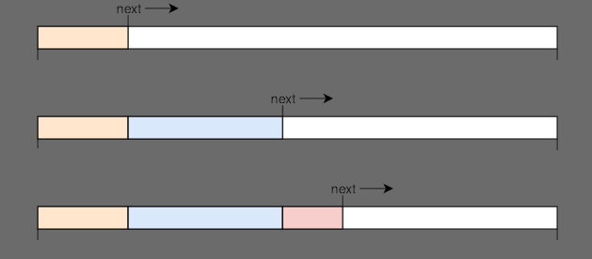
Bump Allocator

Slide 3
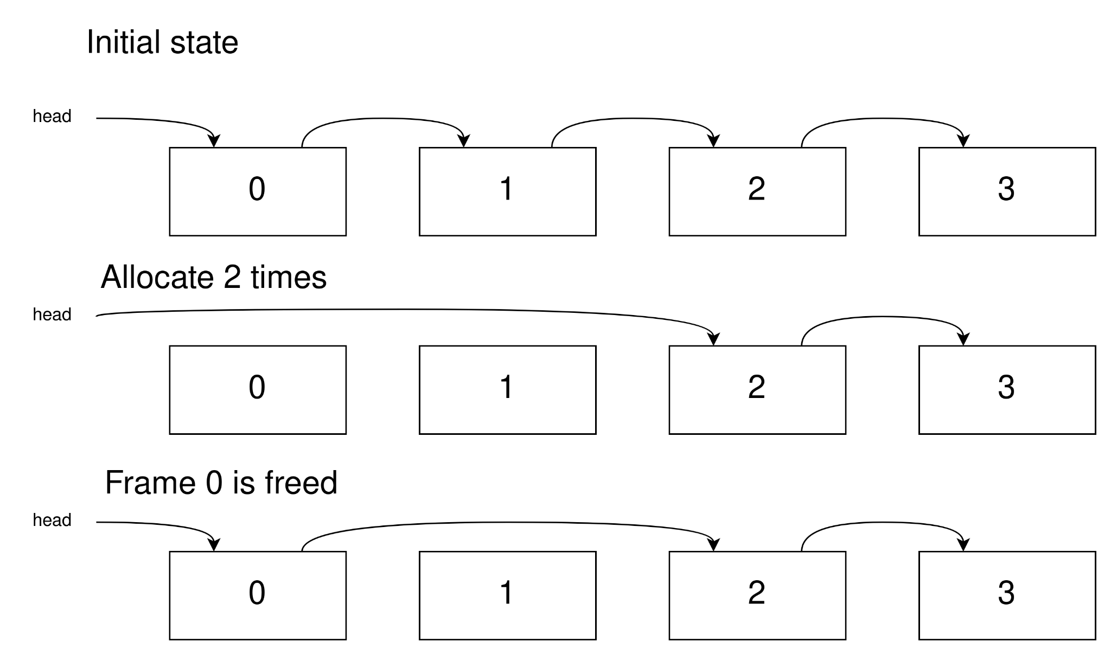
Free Linked List Allocator
O(1) alloc & dealloc
Alloc: no range
No external fragmentation

Slide 4
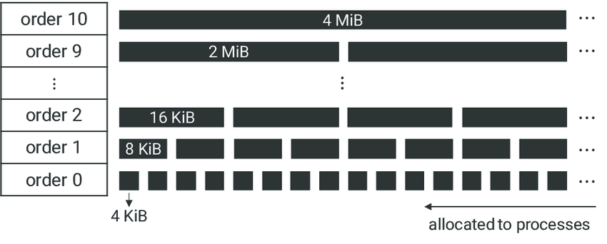
Buddy Allocator
O(log(n)) complexity
No external frag.
Internal frag.

Slide 5
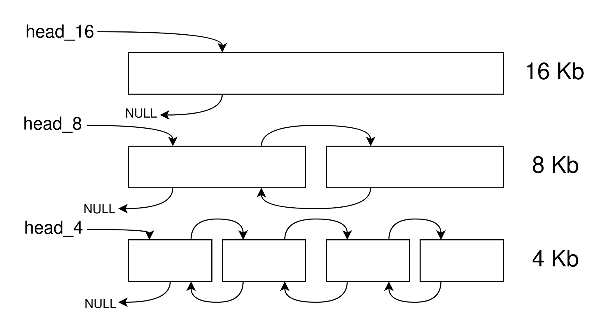
Improved Buddy Allocator: First Idea
Segregated free lists
O(1) to find a block
O(n) worst case to update lists

Slide 6
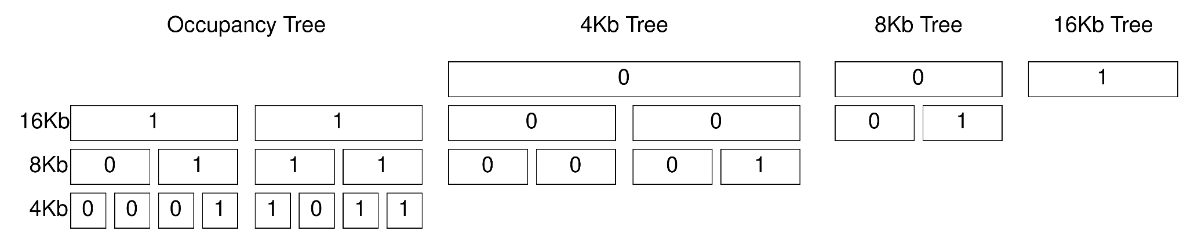
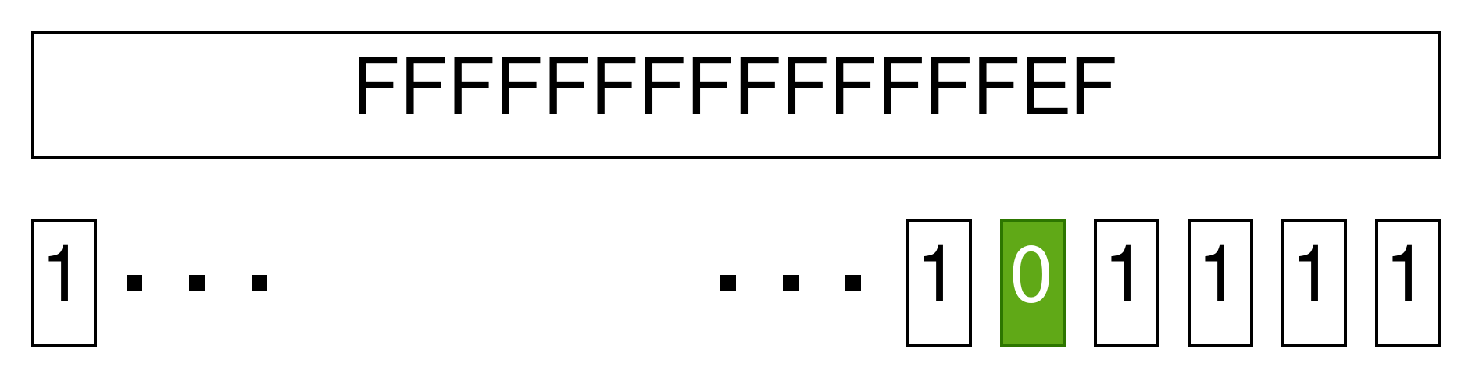
Improved Buddy Allocator: Second Idea
Fixed height
Each block has 64 children
Max 64Gb with 4 levels and 4Kb pages
Blocks of size: - 4Kb - 256Kb - 16Mb - 1Gb
Binary tree for simplification
BSF (Bit Scan Forward) -> next free

